Slide 1
ANALYSIS OF Employee​ ​Satisfaction
ADVAIT KULKARNI SUHIT DATTA
VARAD TUPE

Slide 2


Objective
What drives an employee to make career decisions.
What factors contribute to employee satisfaction and his/her decision to leave the company.
To analyze why some experienced employees leave prematurely from a company.
Building an optimal model to predict employee satisfaction and decision.

Slide 3
Data Description
Field Name | Description
satisfaction_level | Level of satisfaction (0-1)
last_evaluation | Time since last performance evaluation (in Years)
number_project | Number of projects completed while at work
average_montly_hours | Average monthly hours at workplace
time_spend_company | Number of years spent in the company
Work_accident | Whether the employee had a workplace accident
left | Whether the employee left the workplace or not (1 or 0) Factor
promotion_last_5years | Whether the employee was promoted in the last five years
sales | Department in which they work for
salary | Relative level of salary (high, medium, low)

Slide 4
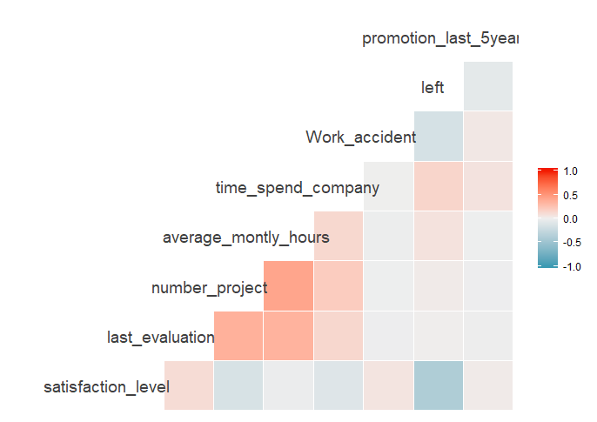
Correlation Plots

Slide 5
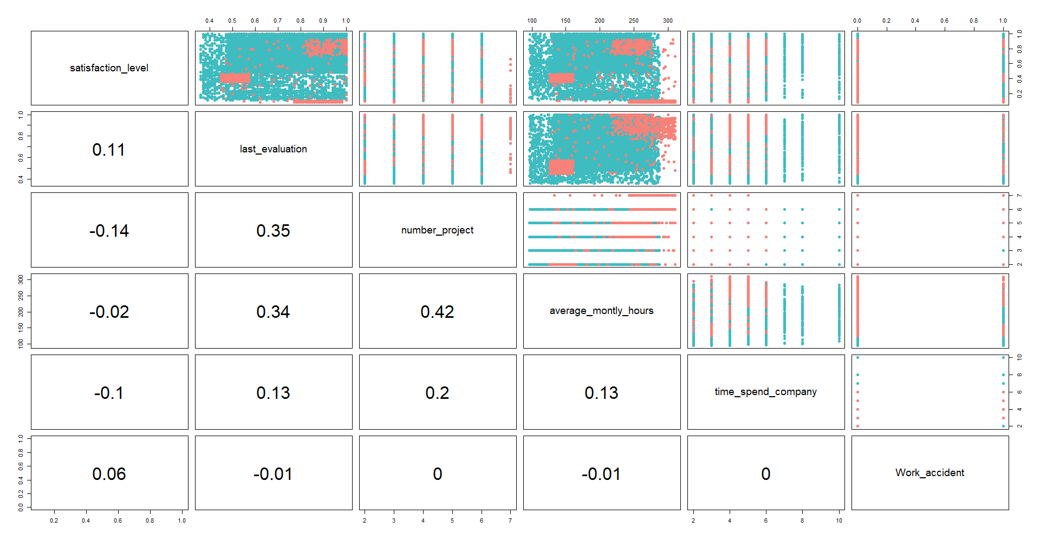

Slide 6
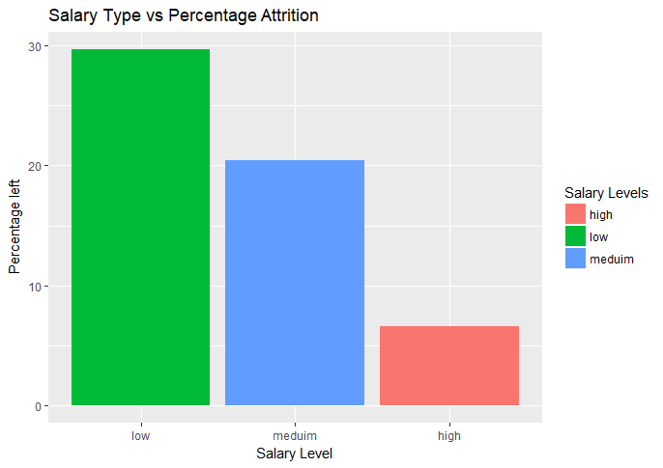
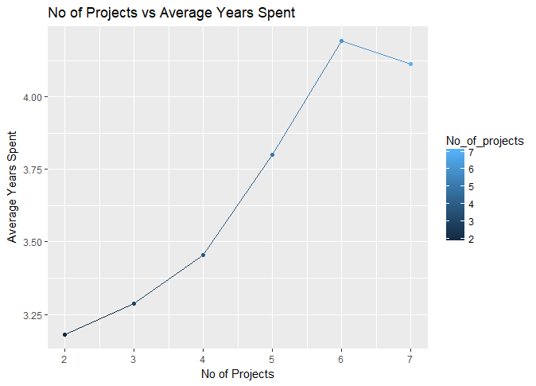
Relationship between No of Projects and the Average Years spent in the Company
Distribution of the Salary Category vs Attrition Percent

Slide 7
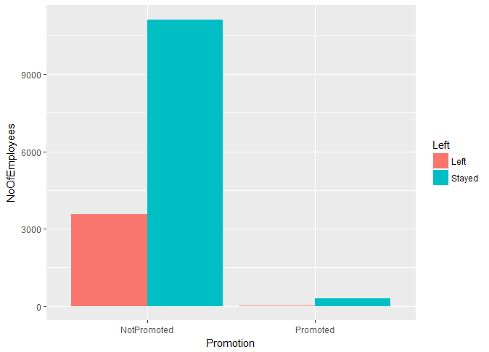
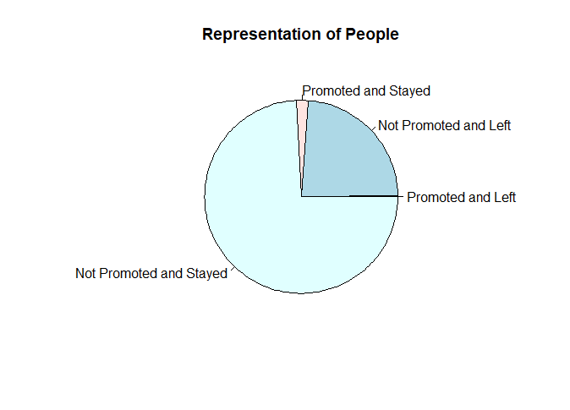
By Promotion in the last 5 years
Almost ¼ th of the people left !

Slide 8
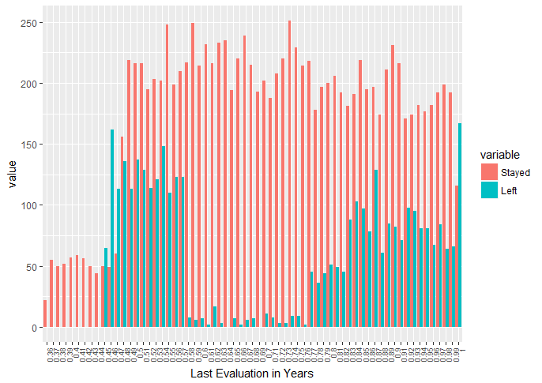
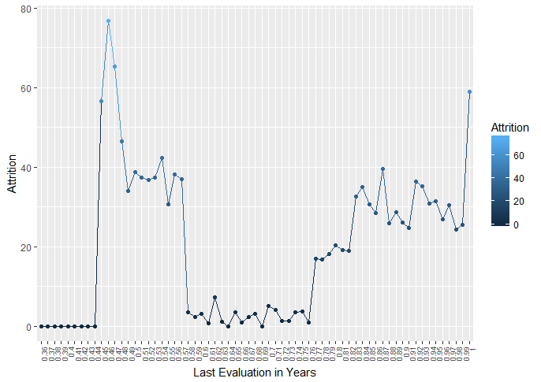
By Last Evaluation

Slide 9
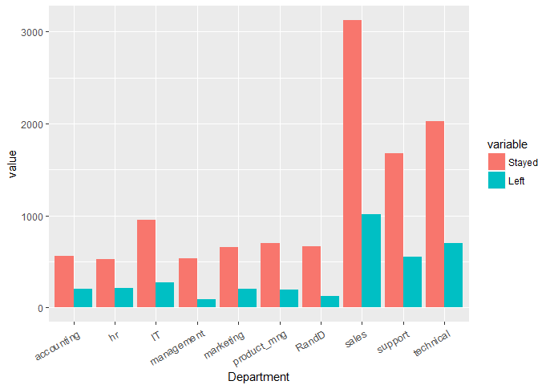
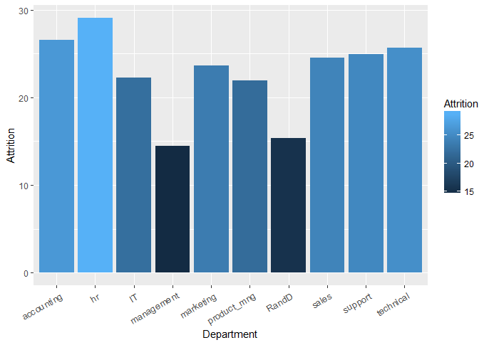
By Department

Slide 10
By Satisfaction Level
Satisfaction Level | Qualitative Equivalent
Greater than 0.8 | Very High
Between 0.6 and 0.8 | High
Between 0.4 and 0.6 | Medium
Between 0.2 and 0.4 | Low
Less than 0.2 | Very Low

Slide 11
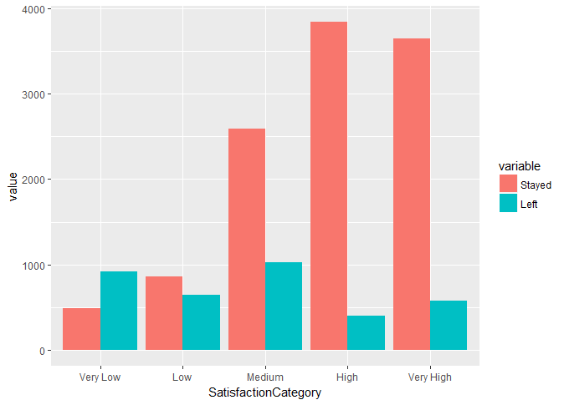
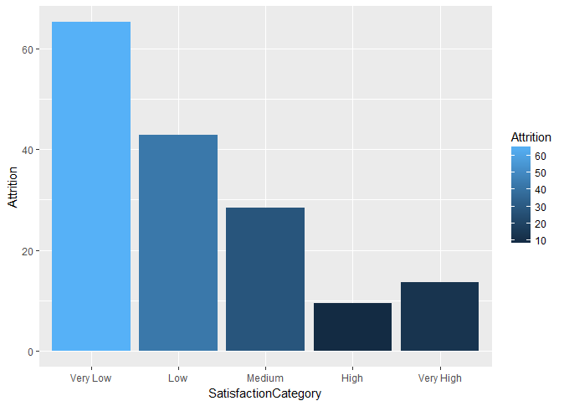

Slide 12
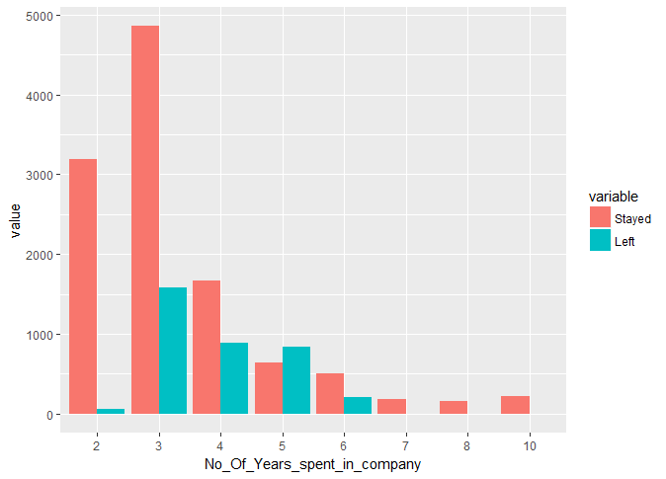
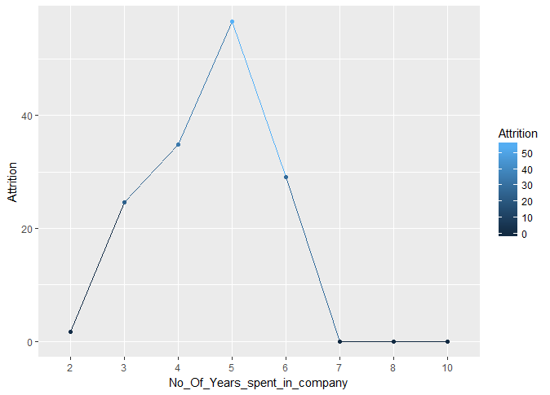
By Number of Years spent in the Company

Slide 13
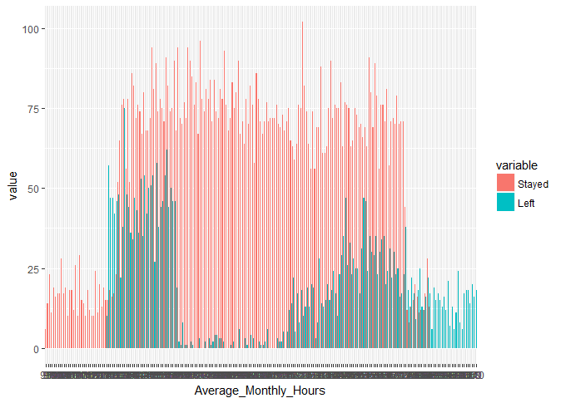
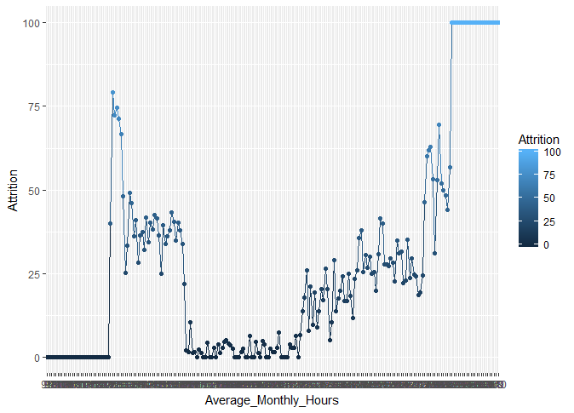
By Average monthly hours spent at Workplace

Slide 14
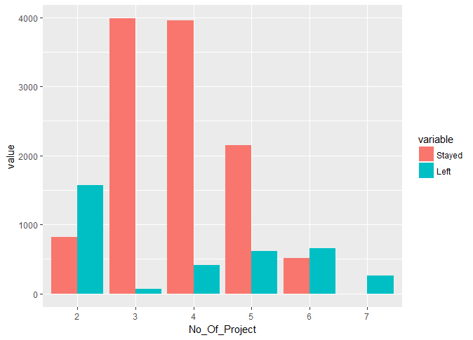
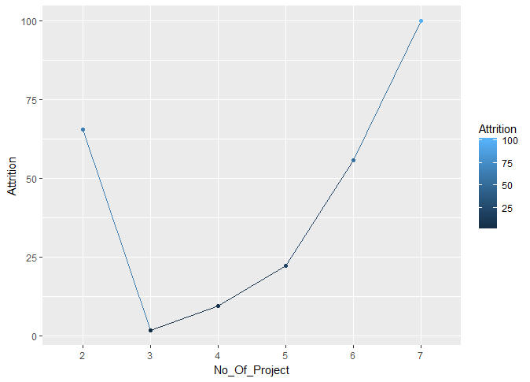
By Number of Projects

Slide 15
Prepping the Data
Predicting Employee Satisfaction using Linear Regression
‘Left’ Parameter indicates if the employee has left the company or not. 1 indicates the person has left and 0 implies the person still works in the company.
Using all variables except the left parameter to predict the Employee Satisfaction.
Predicting if an Employee left or not using Classification Techniques
Excluded the Satisfaction Level for building the Model.

Slide 16
Regression
Objective:
Analyzing the predictors which contribute to employee’s satisfaction.
Predicting the value of Employee satisfaction.
Methods used:
Linear Model
Forward/Backward Subset
Lasso/Ridge
PCA
PLS
Bagging

Slide 17
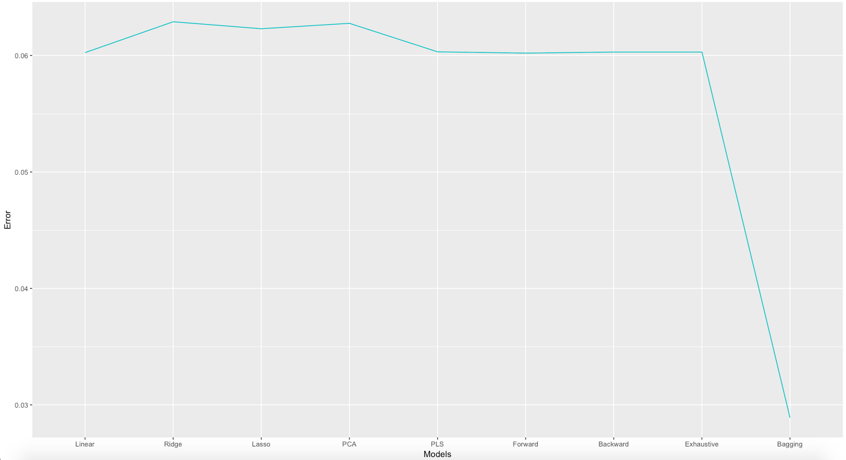
Regression errors :

Slide 18
Classification
Objective:
To efficiently predict which person will leave the company.
Identifying the predictors impacting a person’s decision to leave the company.
Methods used:
Logistic Regression
Linear Discriminant Analysis
Quadratic Discriminant Analysis
Classification Trees
Random Forest
Bagging

Slide 19
Model Performance
Test
Model | Training Error | Test Error
Logistic regression | 21.56% | 31.07%
LDA | 21.69% | 31.22%
QDA | 19.46% | 18.03%
Single Pruned Tree | 2.31% | 3.20%
Random Forest | 1.35% | 2.46%
Bagging | 0.02% | 1.86%
Training

Slide 20
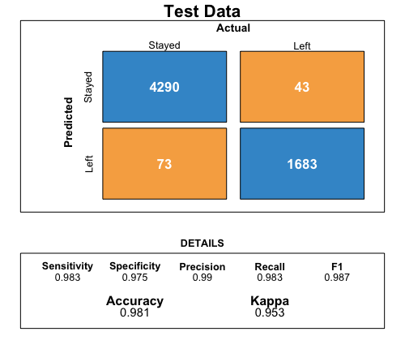
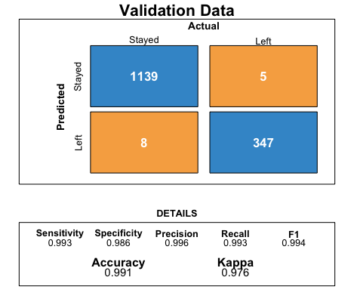
Confusion Matrix for Bagging

Slide 21
Predictor importance for attrition
Predictor Importance

Slide 22
Future Scope
More predictors can be included for a very comprehensive analysis of the satisfaction level of an employee.
The Employee Satisfaction is quantified in the data set. How an abstract value can be quantitatively interpreted needs to thoroughly understood.
An attempt can be made to generalize the model for catering to different organizations.

Slide 23
Conclusion
High negative correlation between satisfaction level and employee’s decision to leave.
Bagging Technique yields optimal result in predicting employee leaving company.
Number of Projects, average monthly hours and last evaluation play important factors in employee’s satisfaction level and his/her decision to leave.

Slide 24


